Slide 1
Human Resource Management System
- SQL Project by Ashwini Harish Poojary

Slide 2
Problem Statement
Maintain company details
Job vacancy details
Candidate application track

Slide 3
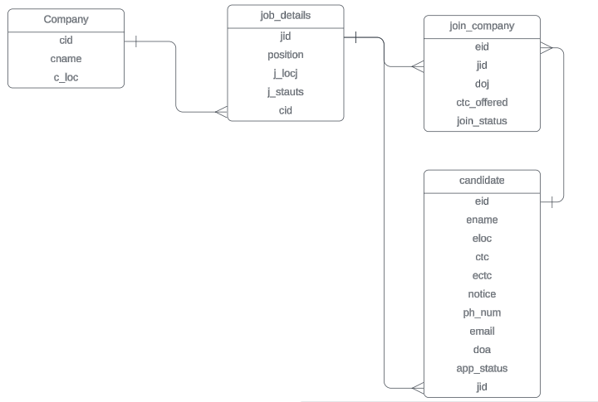
Entity-Relationship Diagram

Slide 4
Thank You

